Slide 1

Chapter 22
Advanced Canvas Programming

Slide 2
Learning Objectives
How the HTML 5 canvas supports linear and radial gradients
How to fill a shape with a pattern using an image
How to repeat or appear to move an image across the canvas using image translation
How to rotate the canvas x and y axis coordinates using image rotation
How the canvas provides functions that developers can use to directly access the pixels that comprise an image

Slide 3
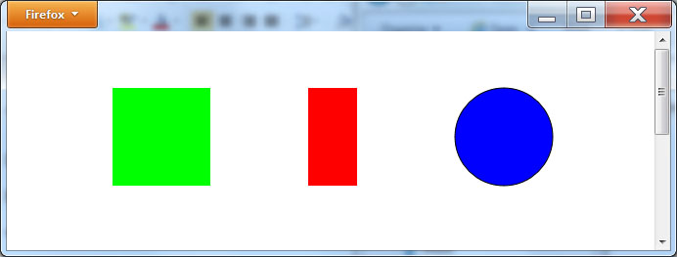
Simple shapes and fills
<!DOCTYPE html> <html> <head> <script> function FillShapes() { var canvas, context; canvas = document.getElementById('myCanvas'); context = canvas.getContext('2d'); context.beginPath(); context.fillStyle = '#00FF00' context.fillRect(100, 50, 100, 100); context.stroke(); context.fillStyle = '#FF0000'; context.fillRect(300, 50, 50, 100); context.stroke(); context.fillStyle = '#0000FF'; context.moveTo(550, 100); context.arc(500,100,50,0,2*Math.PI); context.fill(); context.stroke(); } </script> </head> <body onload="FillShapes()"> <canvas id="myCanvas" width="600" height="400"></canvas> </body> </html>

Slide 4
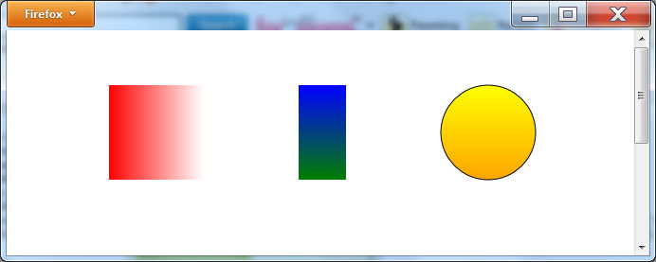
Linear gradients
<!DOCTYPE html> <html> <head> <script> function FillShapes() { var canvas, context, gradient; canvas = document.getElementById('myCanvas'); context = canvas.getContext('2d'); context.beginPath(); gradient = context.createLinearGradient(100,50,200,50); gradient.addColorStop(0,"red"); gradient.addColorStop(1,"white"); context.fillStyle = gradient; context.fillRect(100, 50, 100, 100); context.stroke(); gradient = context.createLinearGradient(300,50,300,150); gradient.addColorStop(0,"blue"); gradient.addColorStop(1,"green"); context.fillStyle = gradient; context.fillRect(300, 50, 50, 100); context.stroke(); gradient = context.createLinearGradient(500,50,500,150); gradient.addColorStop(0,"yellow"); gradient.addColorStop(1,"orange"); context.fillStyle = gradient; context.moveTo(550, 100); context.arc(500,100,50,0,2*Math.PI); context.fill(); context.stroke(); } </script> </head> <body onload="FillShapes()"> <canvas id="myCanvas" width="600" height="400"></canvas> </body> </html>

Slide 5
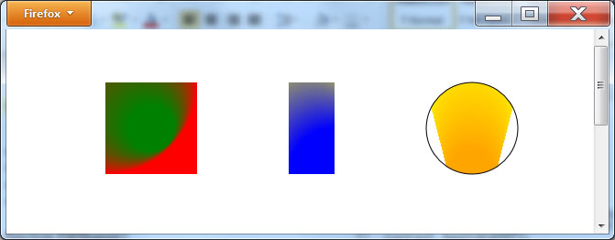
Radial gradients
<!DOCTYPE html> <html> <head> <script> function FillShapes() { var canvas, context, gradient; canvas = document.getElementById('myCanvas'); context = canvas.getContext('2d'); context.beginPath(); gradient = context.createRadialGradient(100,50,100,150,100,25); gradient.addColorStop(0,"red"); gradient.addColorStop(1,"green"); context.fillStyle = gradient; context.fillRect(100, 50, 100, 100); context.stroke(); gradient = context.createRadialGradient(300,50,50,350,150,50); gradient.addColorStop(0,"yellow"); gradient.addColorStop(1,"blue"); context.fillStyle = gradient; context.fillRect(300, 50, 50, 100); context.stroke(); gradient = context.createRadialGradient(500,50,50,500,150,25); gradient.addColorStop(0,"yellow"); gradient.addColorStop(1,"orange"); context.fillStyle = gradient; context.moveTo(550, 100); context.arc(500,100,50,0,2*Math.PI); context.fill(); context.stroke(); } </script> </head> <body onload="FillShapes()"> <canvas id="myCanvas" width="600" height="400"></canvas> </body> </html>

Slide 6
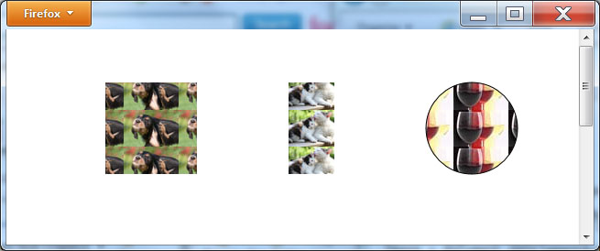
Using a fill pattern
<!DOCTYPE html> <html> <head> <script> function FillShapes() { var canvas, context, image, pattern; canvas = document.getElementById('myCanvas'); context = canvas.getContext('2d'); context.beginPath(); image = document.getElementById("dog"); pattern = context.createPattern(image,"repeat"); context.fillStyle = pattern; context.fillRect(100, 50, 100, 100); context.stroke(); image = document.getElementById("cat"); pattern = context.createPattern(image,"repeat"); context.fillStyle = pattern; context.fillRect(300, 50, 50, 100); context.stroke(); image = document.getElementById("wine"); pattern = context.createPattern(image,"repeat"); context.fillStyle = pattern; context.moveTo(550, 100); context.arc(500,100,50,0,2*Math.PI); context.fill(); context.stroke(); } </script> </head> <body onload="FillShapes()">
<canvas id="myCanvas" width="600" height="400"></canvas> <img id="dog" style="visibility:hidden" src="http://www.websitedevelopmentbook.com/Chapter22/dog.jpg" /> <img id="cat" style="visibility:hidden" src="http://www.websitedevelopmentbook.com/Chapter22/cat.jpg" /> <img id="wine" style="visibility:hidden" src="http://www.websitedevelopmentbook.com/Chapter22/wine.jpg" /> </body> </html>

Slide 7
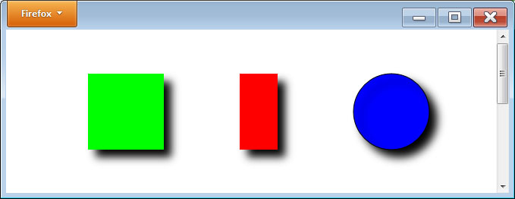
Drop shadows
<!DOCTYPE html> <html> <head> <script> function FillShapes() { var canvas, context; canvas = document.getElementById('myCanvas'); context = canvas.getContext('2d'); context.shadowColor = 'black'; context.shadowOffsetX = 10; context.shadowOffsetY = 10; context.shadowBlur = 10; context.fillStyle = '#00FF00'; context.fillRect(100, 50, 100, 100); context.fillStyle = '#FF0000'; context.fillRect(300, 50, 50, 100); context.stroke(); context.fillStyle = '#0000FF'; context.moveTo(550, 100); context.arc(500,100,50,0,2*Math.PI); context.fill(); context.stroke(); } </script> </head> <body onload="FillShapes()"> <canvas id="myCanvas" width="600" height="400"></canvas> </body> </html>

Slide 8
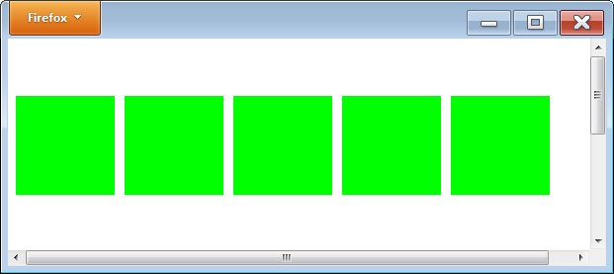
repeating an image on the canvas
<!DOCTYPE html> <html> <head> <script> function FillShapes() { var canvas, context; canvas = document.getElementById('myCanvas'); context = canvas.getContext('2d'); context.fillStyle = '#00FF00'; for (i = 0; i< 500; i = i + 110) { context.fillRect(0, 50, 100, 100); context.translate(110, 0); } } </script> </head> <body onload="FillShapes()"> <canvas id="myCanvas" width="600" height="400"></canvas> </body> </html>

Slide 9
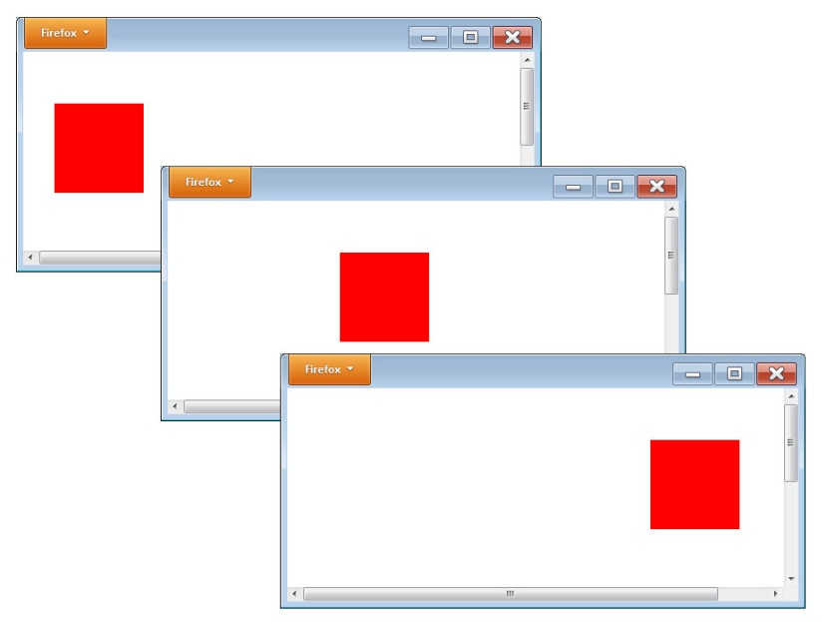
Moving an image across the canvas
<!DOCTYPE html> <html> <head> <script> vari = 0; function FillShapes() { var canvas, context; canvas = document.getElementById('myCanvas'); context = canvas.getContext('2d'); context.fillStyle = '#FF0000'; if (i< 400) { context.clearRect(i-1, 50, 100, 100); context.fillRect(i, 50, 100, 100); ++i; setTimeout(function() { FillShapes(); }, 10); } } </script> </head> <body onload="FillShapes()"> <canvas id="myCanvas" width="600" height="400"></canvas> </body> </html>

Slide 10
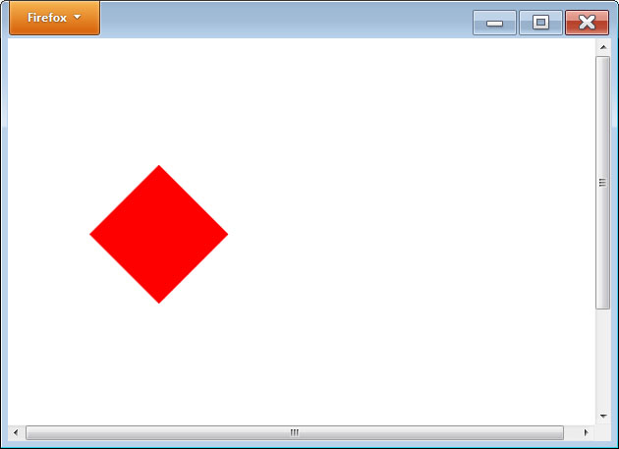
Rotating the canvas
<!DOCTYPE html> <html> <head> <script> function RotateSquare() { var canvas, context; canvas = document.getElementById('myCanvas'); context = canvas.getContext('2d'); context.fillStyle = '#FF0000'; context.translate(75, 50); context.rotate(Math.PI/180*45); context.fillRect(100, 0, 100, 100); } </script> </head> <body onload="RotateSquare()"> <canvas id="myCanvas" width="600" height="500"></canvas> </body> </html>

Slide 11
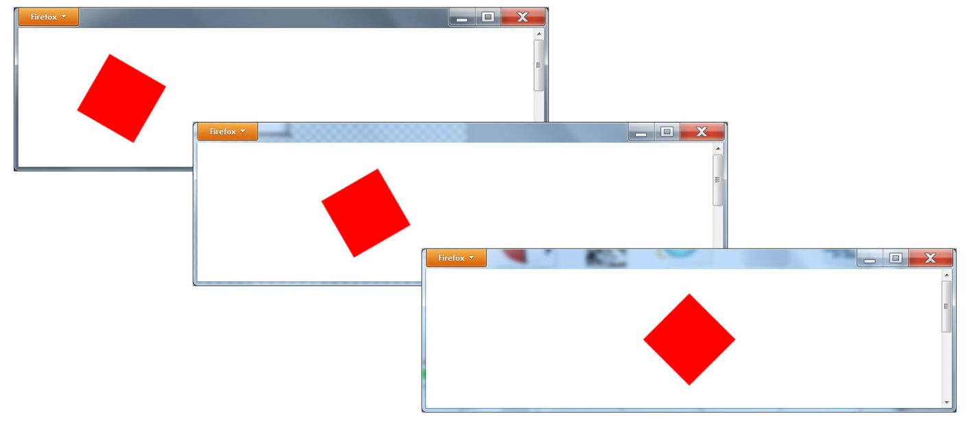
Tumbling an image across the canvas
<!DOCTYPE html> <html> <head> <script> vari = 0; var Degree = 0; function FillShapes() { var canvas, context; canvas = document.getElementById('myCanvas'); context = canvas.getContext('2d'); context.save(); context.fillStyle = '#FF0000'; if (i< 700) { context.clearRect(0, 0, 800, 400); context.translate((100+i)/2, 100); context.rotate(Math.PI/180*Degree); context.fillRect(-50, -50, 100, 100); i = i + 10; Degree = Degree + 15; setTimeout(function() { FillShapes(); }, 100); } context.restore(); } </script> </head> <body onload="FillShapes()"> <canvas id="myCanvas" width="600" height="400"></canvas> </body> </html>

Slide 12
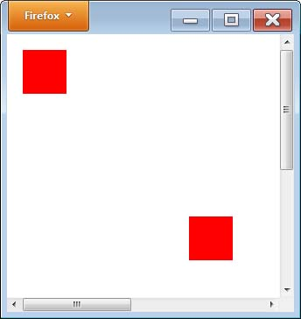
Manipulating pixel data
<!DOCTYPE html> <html> <head> <script> function GetImageData() { varImageData, canvas, context; canvas = document.getElementById('myCanvas'); context = canvas.getContext('2d'); context.fillStyle='#ff0000'; context.fillRect(10,10,50,50); ImageData = context.getImageData(10, 10, 50, 50); context.putImageData(ImageData, 200, 200); } </script> </head> <body onload="GetImageData()"> <canvas id="myCanvas" width="600" height="500"></canvas> </body> </html>

Slide 13
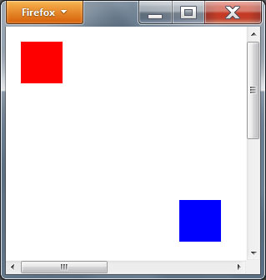
Changing an image’s color values
<!DOCTYPE html> <html> <head> <script> function GetImageData() { var ImageData, canvas, context; canvas = document.getElementById('myCanvas'); context = canvas.getContext('2d'); context.fillStyle='#ff0000'; context.fillRect(10,10,50,50); ImageData = context.getImageData(10, 10, 50, 50); var imageData = ImageData.data; var i ; for (i = 0; i<imageData.length; i+= 4 ) { imageData[i] = 0; // red imageData[i+1] = 0; // green imageData[i+2] = 255; // blue } context.putImageData(ImageData, 200, 200); } </script> </head> <body onload="GetImageData()"> <canvas id="myCanvas" width="600" height="500"></canvas> </body> </html>

Slide 14

Real World: 3d with webgl

Slide 15
summary
This chapter examined more advanced graphics programming capabilities, such as drop shadows, gradients, image rotation and translation, and direct access of an image’s pixel data.
Using the concepts this chapter presents, you can animate the display of a wide range of images.

